Slide 1


OKACOGNET: Understanding functional connectivity in resting state: a network based approach
Jaime Gomez-Ramirez
Biomedical Engineering Laboratory,
Okayama University

Slide 2
OKACOGNET
Context
Approach
Results
Future works

Slide 3
Context
Objective
Graph Analysis to study fMRI resting-state functional connectivity
Approach
Use network theory (graph) to study global connectivity in the human brain
Benefit
Understand functional significance of resting-state
Quantitative study of human brain global connectivity
Potential application to network characterisaton of AD,MCI etc. in early detection and prognosis

Slide 4
Context
Challenges:
A different approach to the Stimulus-Task
No goal oriented or external stimulus, but study brain dynamics in resting state
Quantify Endogeous brain activity

Slide 5
Approach ICA
OKACOGNET follows 2 Approaches :
Independent Component Analysis ICA
Graph-based

Slide 6
Approach ICA
23 healthy subjects in resting state
Independent Component Analysis ICA
Use GIFT (Matlab toolbox that implements multiple algorithms for ICA)
ICA is model-free in contrast with GLM
ICA-based studies allow to simultaneously decompose into several maps, providing a set of components in which resting state networks can be studied.
ICA doesn’t require predefined ROI or the identification of seed voxel location.

Slide 8
Approach ICA
We have found a network of 20 nodes related to DMN:
LCaS(30) LFG(37) RFG(37) LIPL(40) RSupraMarginal(40) RMTG(37) LSupraMarginal(22) RPCC(23) RIPL(40) LPCU(7) RPCU(23) LPCC(23) RMFG(9) RSFG(8) LSTG(48) LMFG(9) RACC(32) RTP(38) L(para)Hipp(20) RMPFG(10) LMPFG(10)
Notes:
Brodmann's cytologically defined regions of the brain.

Slide 9
Graph-based approach
DATA: 23 healthy subjects in resting state
OBJECTIVE Functional brain networks at temporal scale

Slide 10
STEPS:
Preprocessing: (no smooth) (Li Yuzie)
Whole brain parcelated in 90 areas using AAL (prior anatomical atlas)
Calculate mean time series of each region

Slide 11
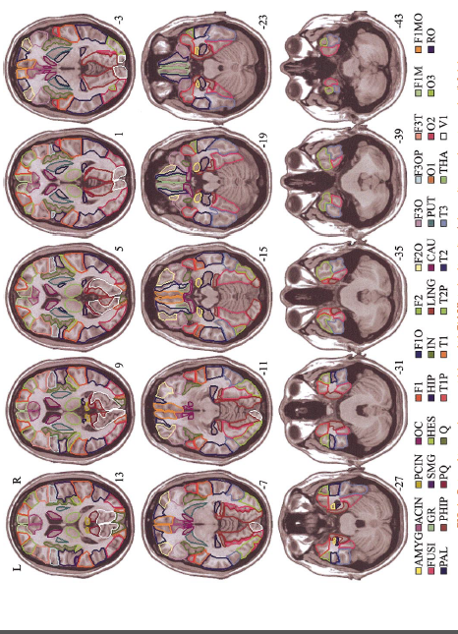
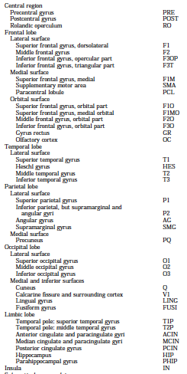

Slide 12
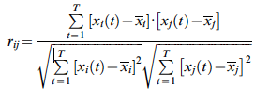
Tools
Calculate temporal correlation matrix (90x90) for each subject using Pearson coefficients (t=1:172)

Slide 13
T-test to study inter-regional correlation (Z-transform) for the 23 subjects
Bonferroni-Holmes corrected significance level p
We obtain adjacency matrix M 90x90 for binary undirected graph
We transform matrix M into undirected binary graph (using Pajek)
Network analysis

Slide 14
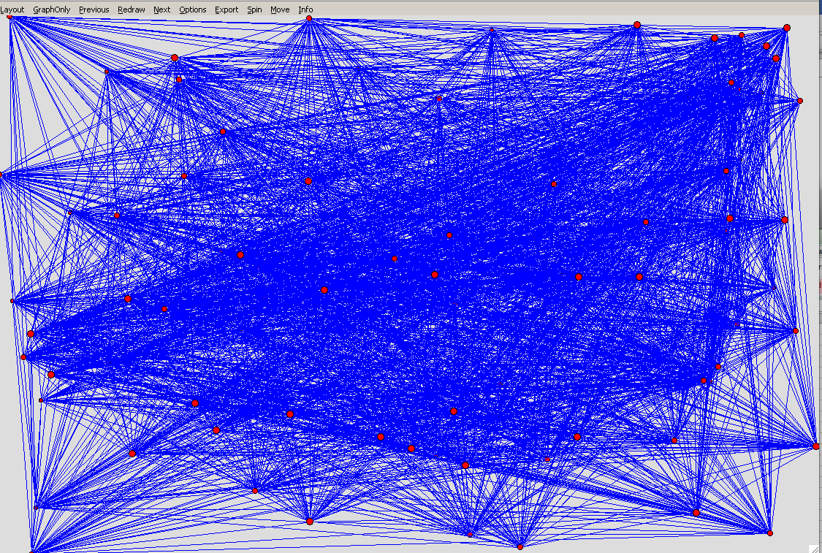

Slide 17
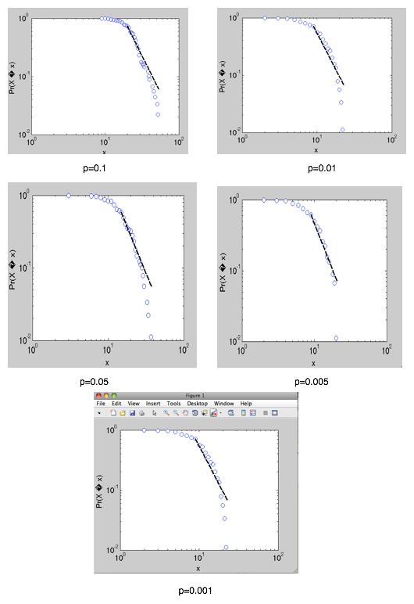

Slide 18
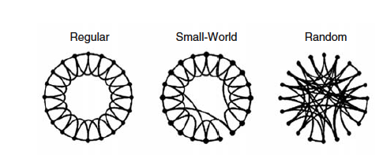
Short paths and high clustering:
Fast communication between distant nodes facilitating synchronization
Support both Segregation/Integration
Likely transitivity property:
A->B , B->C high prob that A -> C
Notes:
A scale-free network is a connected graph or network with the property that the number of links k originating from a given node exhibits a power law distribution P(k)∼k^(-gamma). A scale-free network can be constructed by progressively adding nodes to an existing network and introducing links to existing nodes with preferential attachment so that the probability of linking to a given node i is proportional to the number of existing links k_i that node has, i.e.,

Slide 19
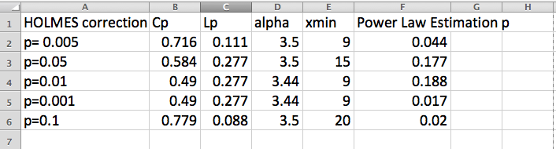
Cp= Clustering coefficient. The clustering coefficient is the fraction of triangles around a node
(the fraction of nodes neighbors that neighbors of each other).
Lp= Characteristic path length, 1/ global efficiency,

Slide 20
Tools
SPM (preprocessing)
Matlab (statistical calculations)
SPSS (statistical calculations)
R (statistical calculations)
Pajek (visualization network)

Slide 21
Tools
Functional brain networks at spatial scale
Understand network robustness
Graph based approach with new experimental cases
AD, MCI, Parkinson (we need more data: age-related control subjects)
How network connectivity , clustering affect robustness

Slide 22
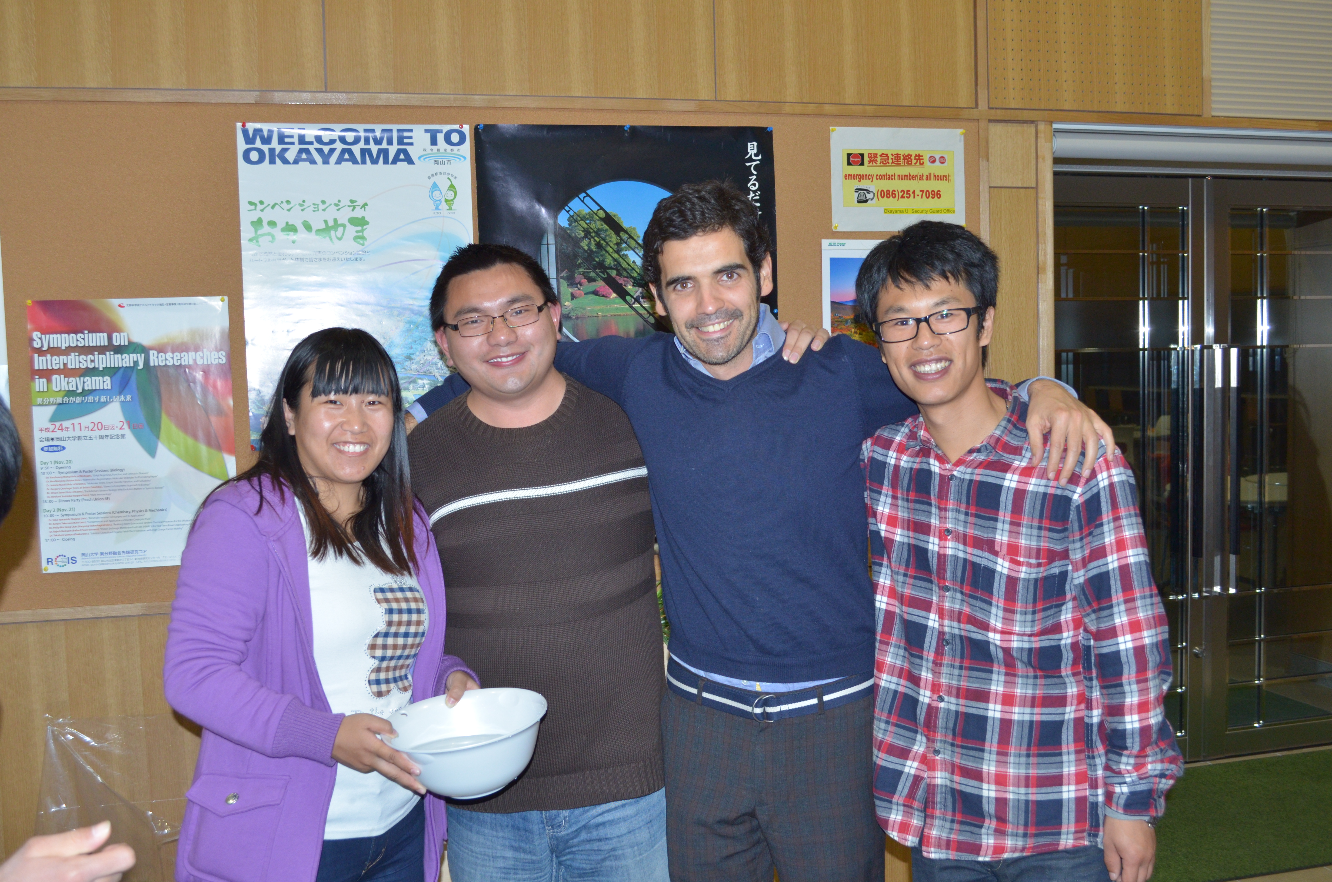
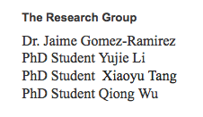
Thanks!

